Slide 1
Volumetric Segmentation via Neural Networks Improves Neutron Crystallography Data Analysis
Brendan Sullivan sullivanbt@ornl.gov
HPML2019 CCGrid 2019

Slide 2
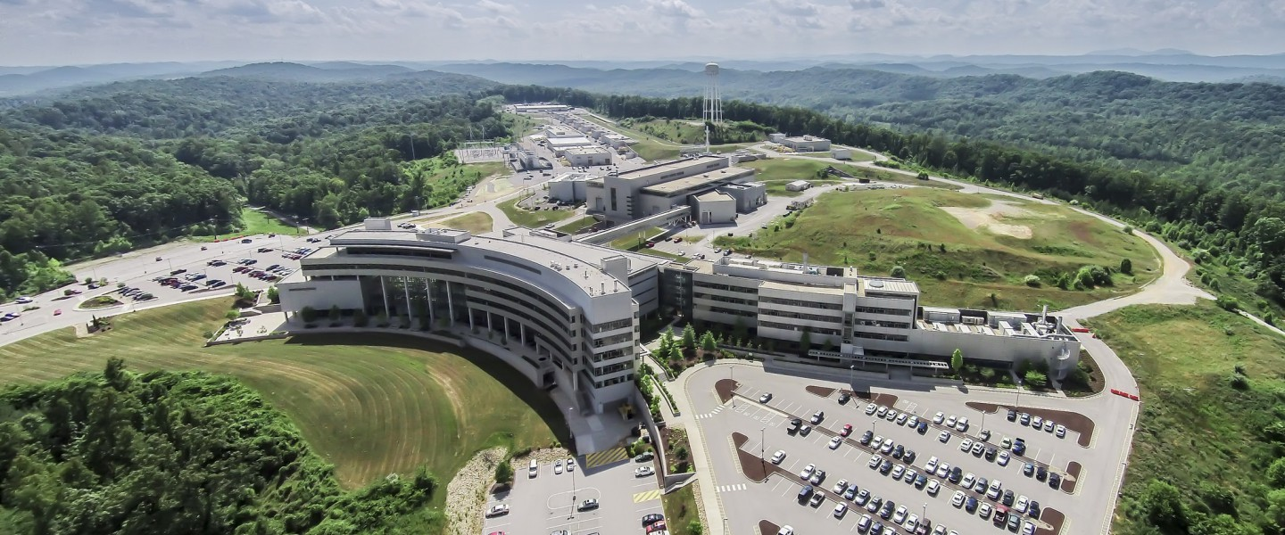
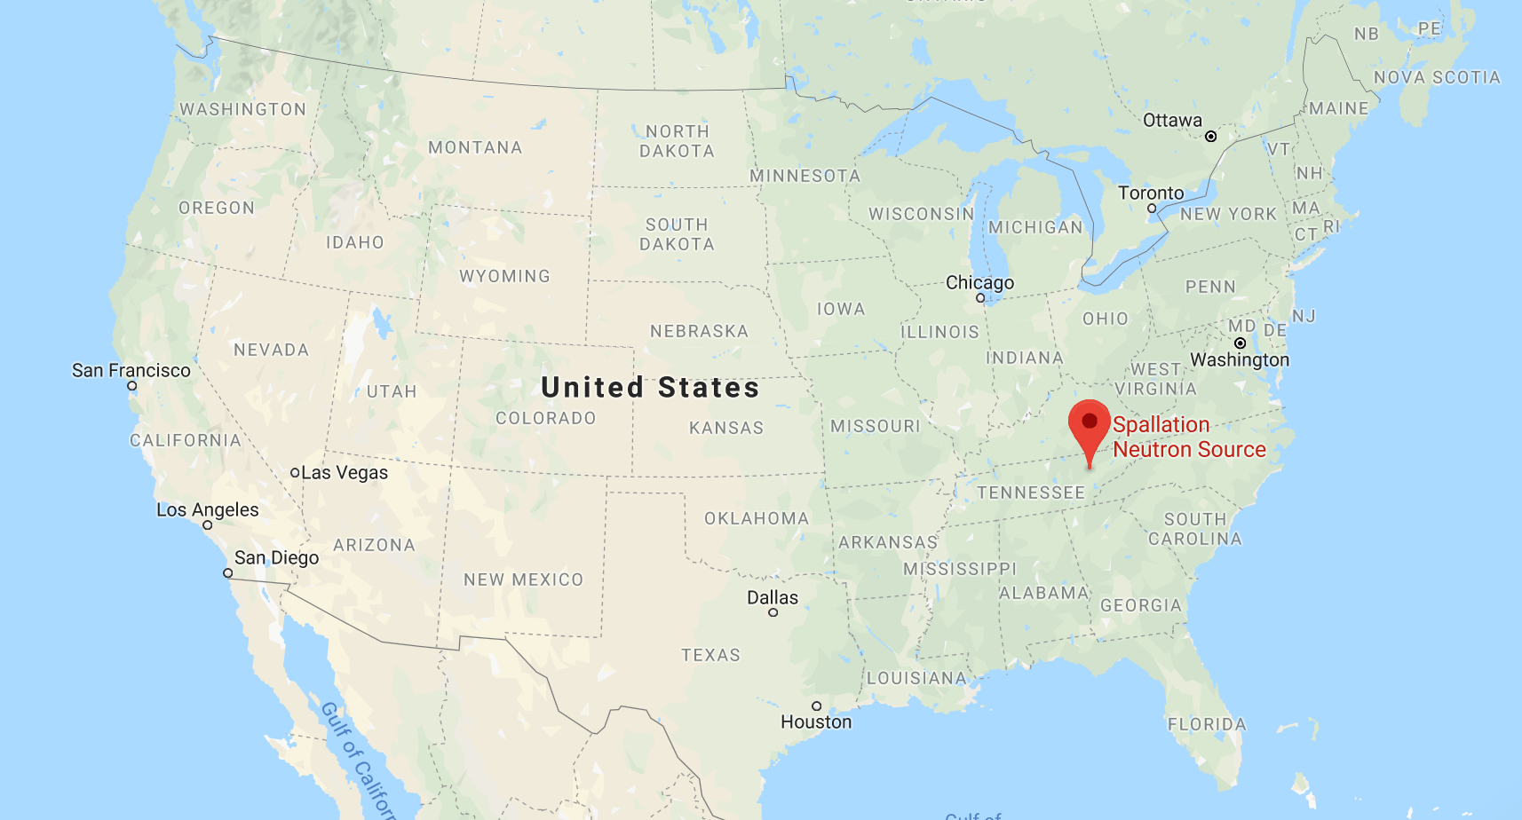
Oak Ridge National Laboratory hosts the Spallation Neutron Source (SNS) and High Flux Isotope Reactor (HFIR)

Slide 3
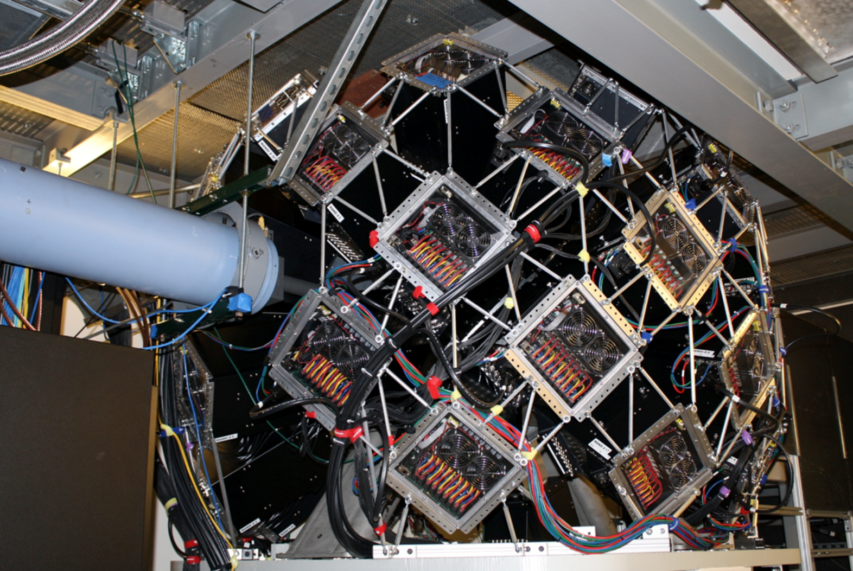
Oak Ridge National Laboratory hosts the Spallation Neutron Source (SNS) and High Flux Isotope Reactor (HFIR)
Over 1,000 users in 2018 conducted experiments
Users apply for beamtime through peer-reviewed process
Beamtime is limited, need to make sure experiments are run optimally and data are analyzed thoroughly
Support a large number of techniques, including neutron crystallography
The detector array at the MaNDi
crystallography Beamline at the SNS

Slide 4
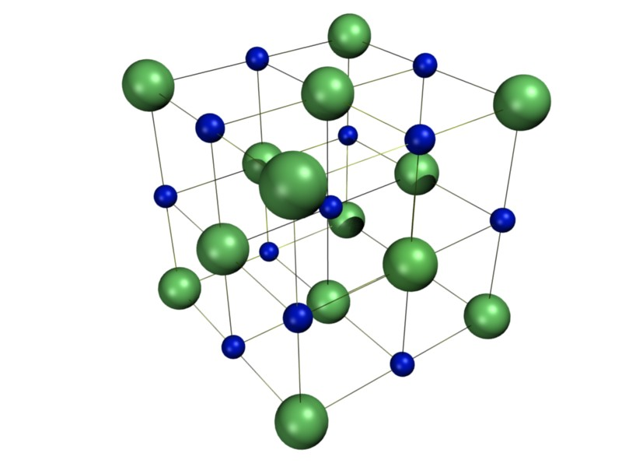
Crystallography is the powerhouse technique for molecular structure determination
The planes of a single act like slits for diffraction
The maxima are known as Bragg Peaks or Bragg Spots
Discovered in early 1900s and used for small molecule structures (e.g. diamond, NaCl)
Protein crystallography is the workhorse for structural biology
Drug-protein interactions
Researching biomimetic technologies

Slide 5
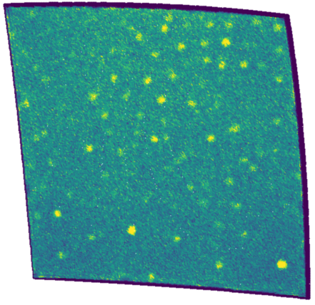
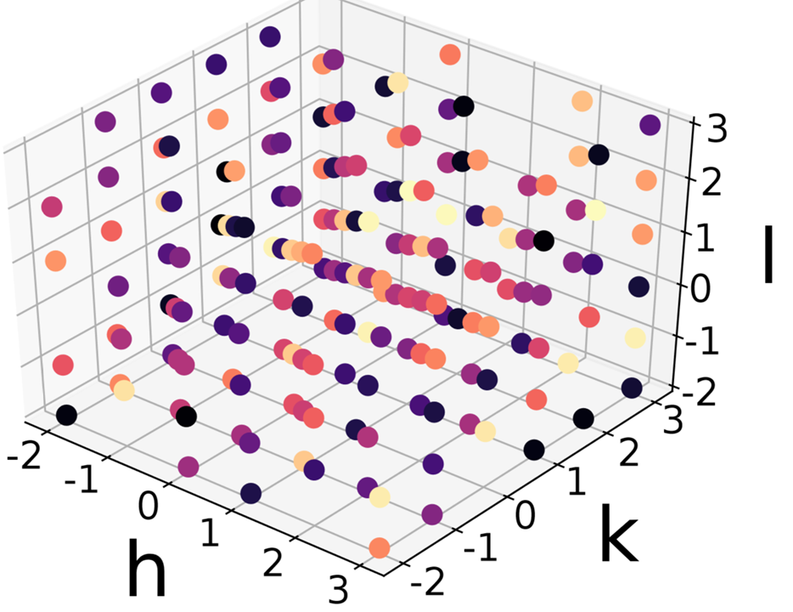
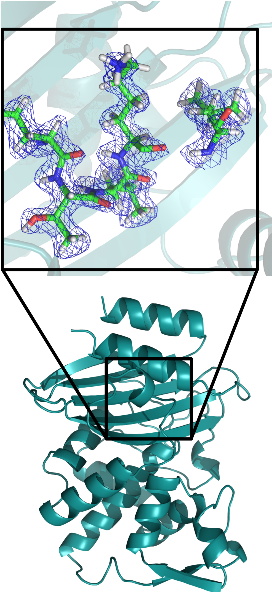
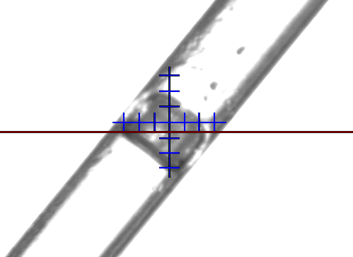
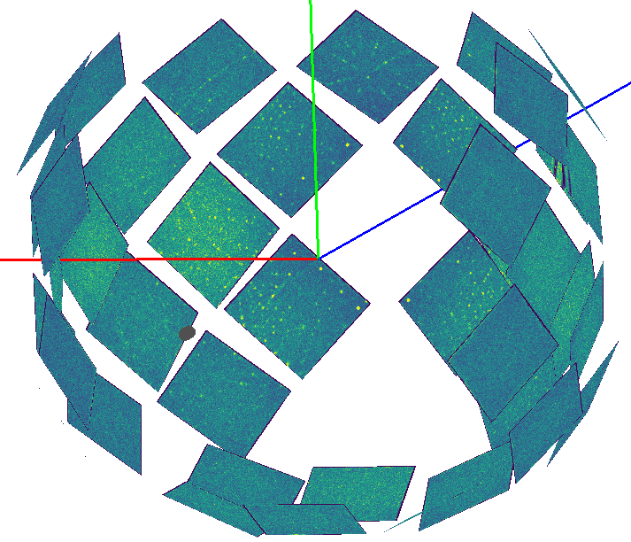
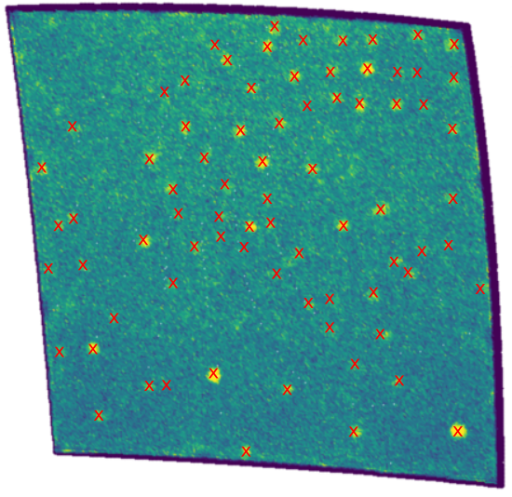
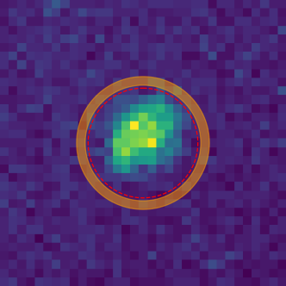
A standard crystallography experiment requires a collection of Bragg peaks to be integrated
Sample Growth and Data Collection
Find, Index and Predict Peaks
Integrate Peaks
Fourier Transform to Real Space and Model Building
×100,000

Slide 6
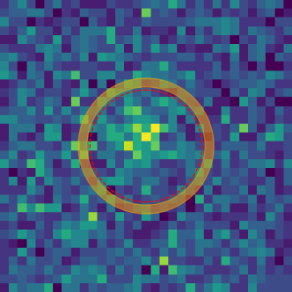
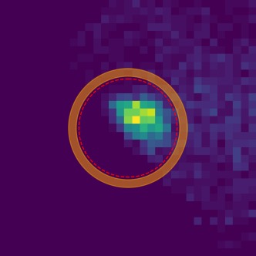
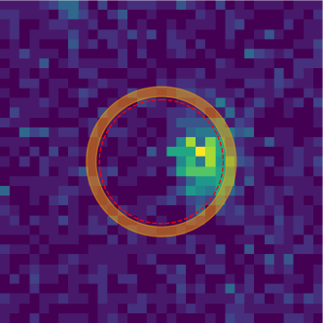
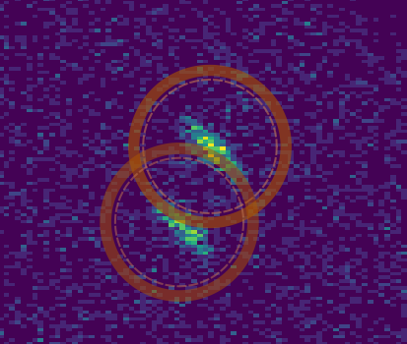
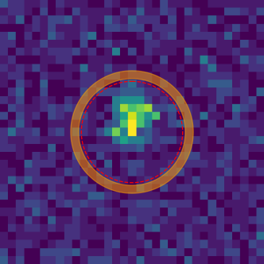
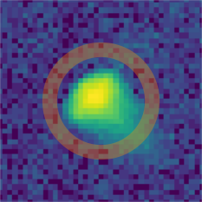
There are several shortcomings for peak-minus-background approaches
Weak Peaks
Inaccurate Peak
Adjacent and
Detector Edges
Prediction
Overlapping Peaks
Complicated
Peak Shapes
Varying Peak Sizes

Slide 7
Overview
Quick overview of Bragg Peak integration using profile fitting
Peak integration as an image segmentation problem
Apply machine learning to integrating Bragg peaks
Generating appropriate training sets
Carrying out the integration
Validating the results
Performance Comparison
Transfer learning
Future applications

Slide 8
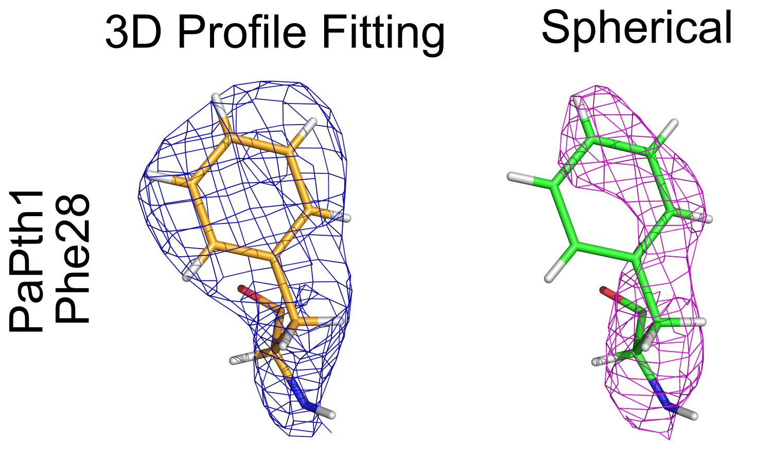
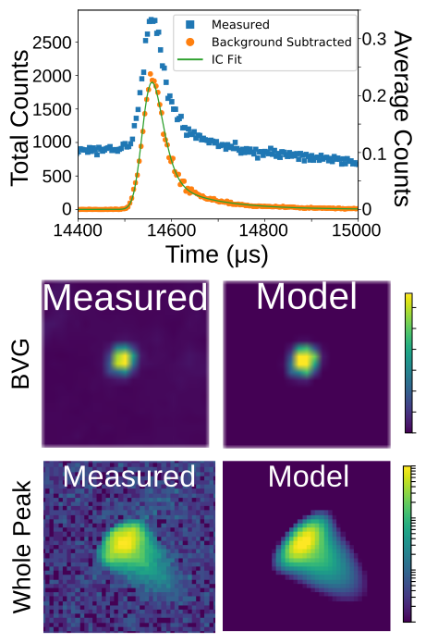
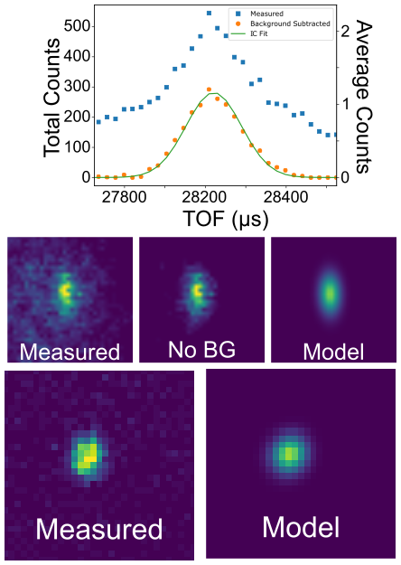
We can model a Bragg Peak in reciprocal space as a TOF component times a Bivariate Gaussian
Bragg peaks are 3D intensity profiles in reciprocal space
The time of flight direction is described by an Ikeda-Carpenter function
A Bivariate Gaussian describes the remaining two directions
Using this for peak shape in 3D recovers peak shape
Improves statistics and extends resolution by ~0.3 Å

Slide 9
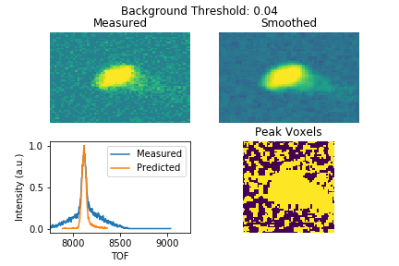
Determining the background is done by trial and error and is a computationally expensive process
Most accurate method has been to do least squares fit for each background level to known profile
This takes ~1s per peak, need to integrate ~100,000
End product is the set of voxels that make up a peak
Volumetric segmentation

Slide 10
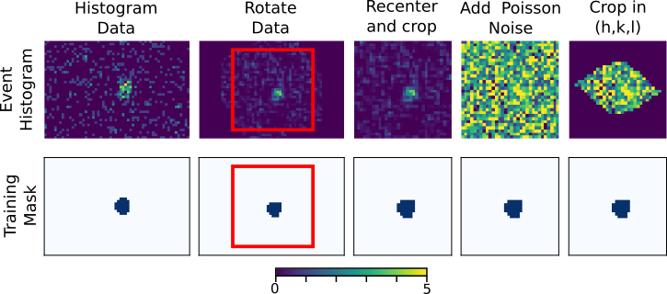
Training peaks are augmented from measured strong peaks
I/max(I) > 0.15
Can easily fit strong peaks – threshold to get a mask
Need to simulate different orientations, mispredict locations, weak peaks (strong noise)

Slide 11
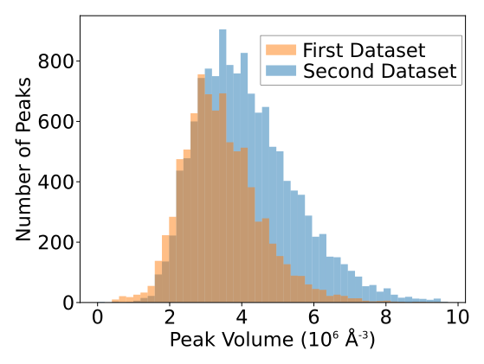
We use two datasets from two crystals of the same protein as a starting point for looking at transfer learning
Two datasets recorded with same instrument configuration
Crystal for second dataset diffracts more strongly
Both training sets created using same algorithm
Dataset 1 has ~10k peaks, Dataset 2 has ~15k peaks
Mixed training set used 5k from each
Size of training peaks for each dataset

Slide 12
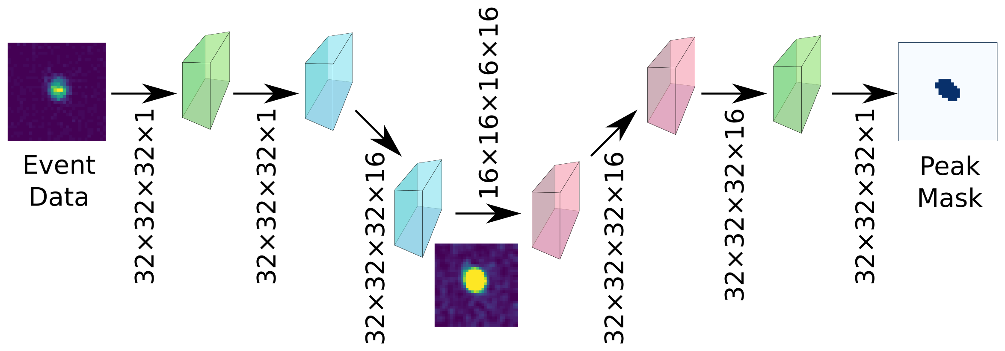
A small neural network similar to a U-Net is used to learn peak shapes from training data
Train against ~10k training peaks generated from strong peaks
ADAM optimizer, lr = 0.0005, β₁=0.9, β₂=0.999
Includes dropout layers (0.5 dropout rate) and BatchNormalization layers
Total of 103,873 trainable variables and 320 nontrainable
80% training, 10% validation, 10% test from training set

Slide 13
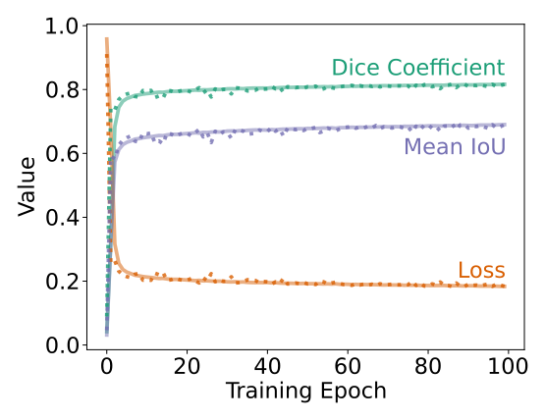
Using a small network based on a U-Net the network is able to learn peak shapes
For training and prediction, scale data to have zero mean and unit variance
Loss function: 1-Dice Coefficient
Routinely achieve Dice coefficients of 0.82, mean IoUs of 0.69 for training, validation, and testing sets.
For negative control, fit to random peaks. 0.15 Dice Coefficient

Slide 14
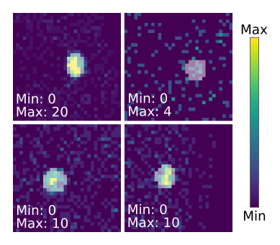
Trained network successfully segments peaks over a variety of intensities
Predicts non-training peaks reliably
For weakest peaks, cannot visually determine if prediction is accurate
Integration to get intensity and variance: $I=ΣN_{i}−nλ_{BG}$
$$σ^{2}\left(I\right)=ΣN_{i}+nλ_{BG}$$
Need to quantitatively assess integration for consistency (merging statistics) and accuracy (intensity statistics)
Keep I/σ > 1 for each integration method

Slide 15
Merging statistics measure consistency of integrated intensities
Dataset 2
Dataset 1
$$R_{p.i.m.}=\frac{\sum_{h}{\sqrt{\frac{1}{n_{h}−1}}\sum_{h}^{n_{h}}{|I_{h,i}−\overline{I_{h}}|}}}{\sum_{h}{\sum_{i}{I_{h,i}}}}$$
$$R_{merge}=\frac{\sum_{h}{\sum_{i}{|I_{h,i}−\overline{I_{h}}|}}}{\sum_{h}{\sum_{h}^{n_{h}}{I_{h,i}}}}$$

Slide 16
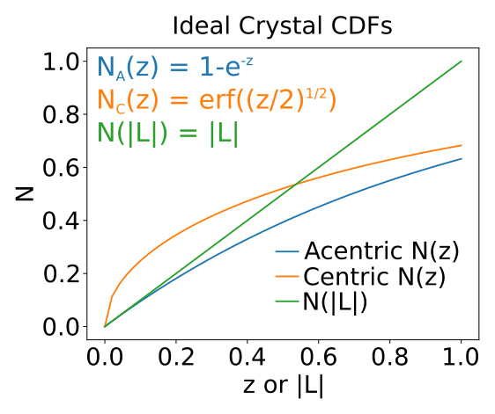
Ideal crystals have known intensity statistics that we can use to evaluate integration scheme performance
Series of tests based on intensity statistics
Usually diagnose issues with sample
From X-ray we know these are nearly perfect crystals, so we use to assess integration scheme
N(z) tests measure the distribution of intensities
N(|L|) tests variations in local intensity
$$z=\frac{I}{<I>}$$
$$L=\frac{I_{1}−I_{2}}{I_{1}+I_{2}}$$

Slide 17
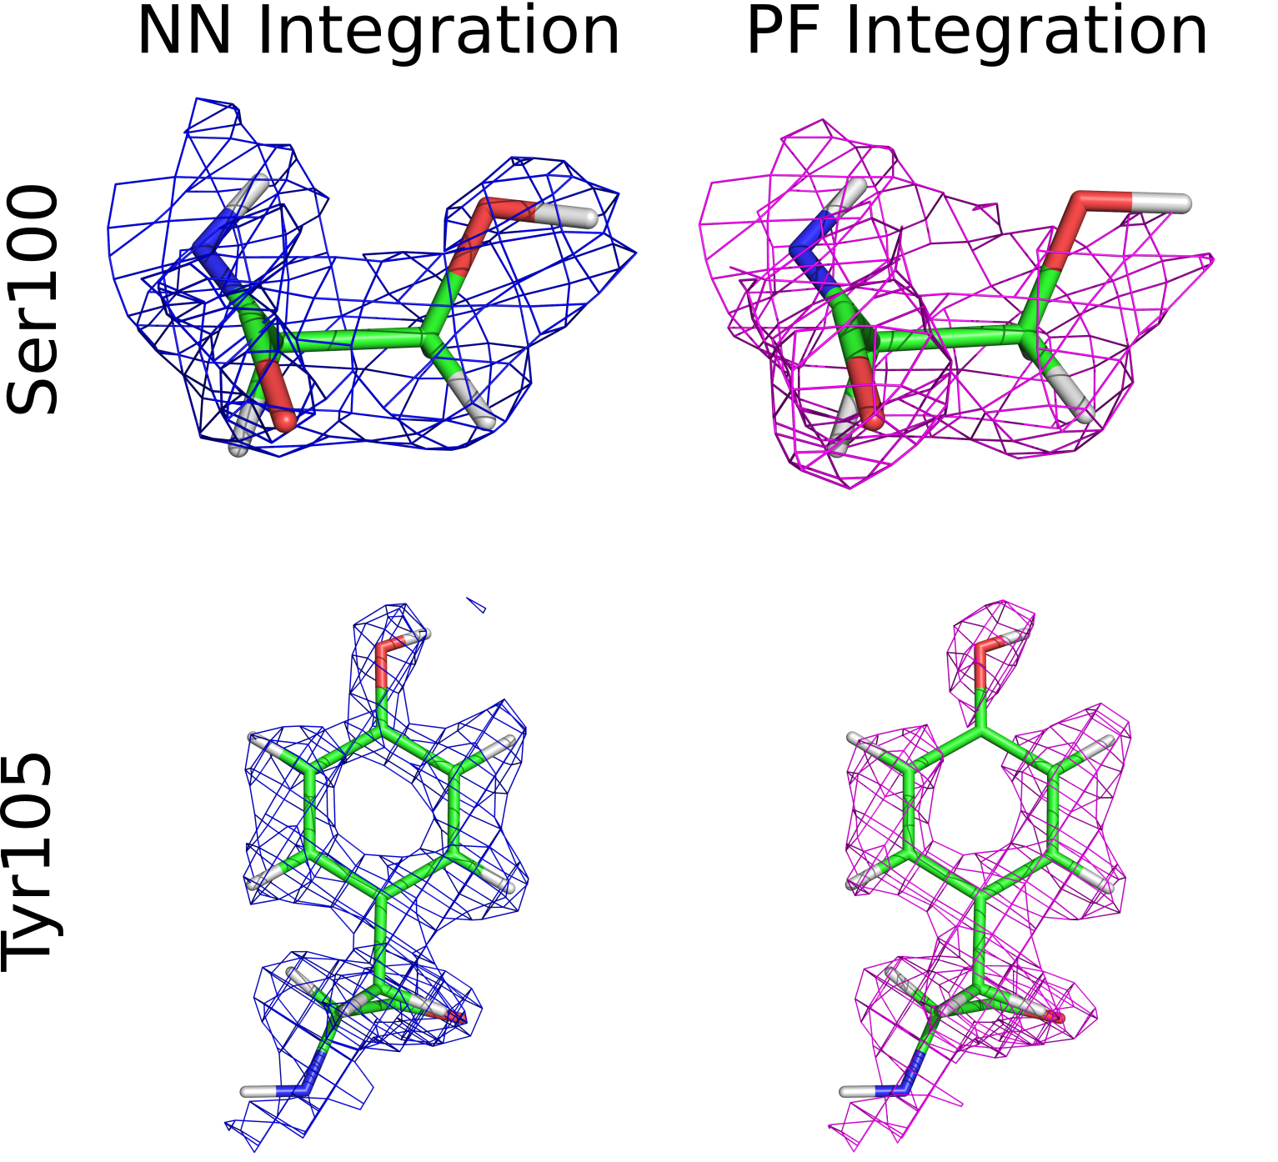
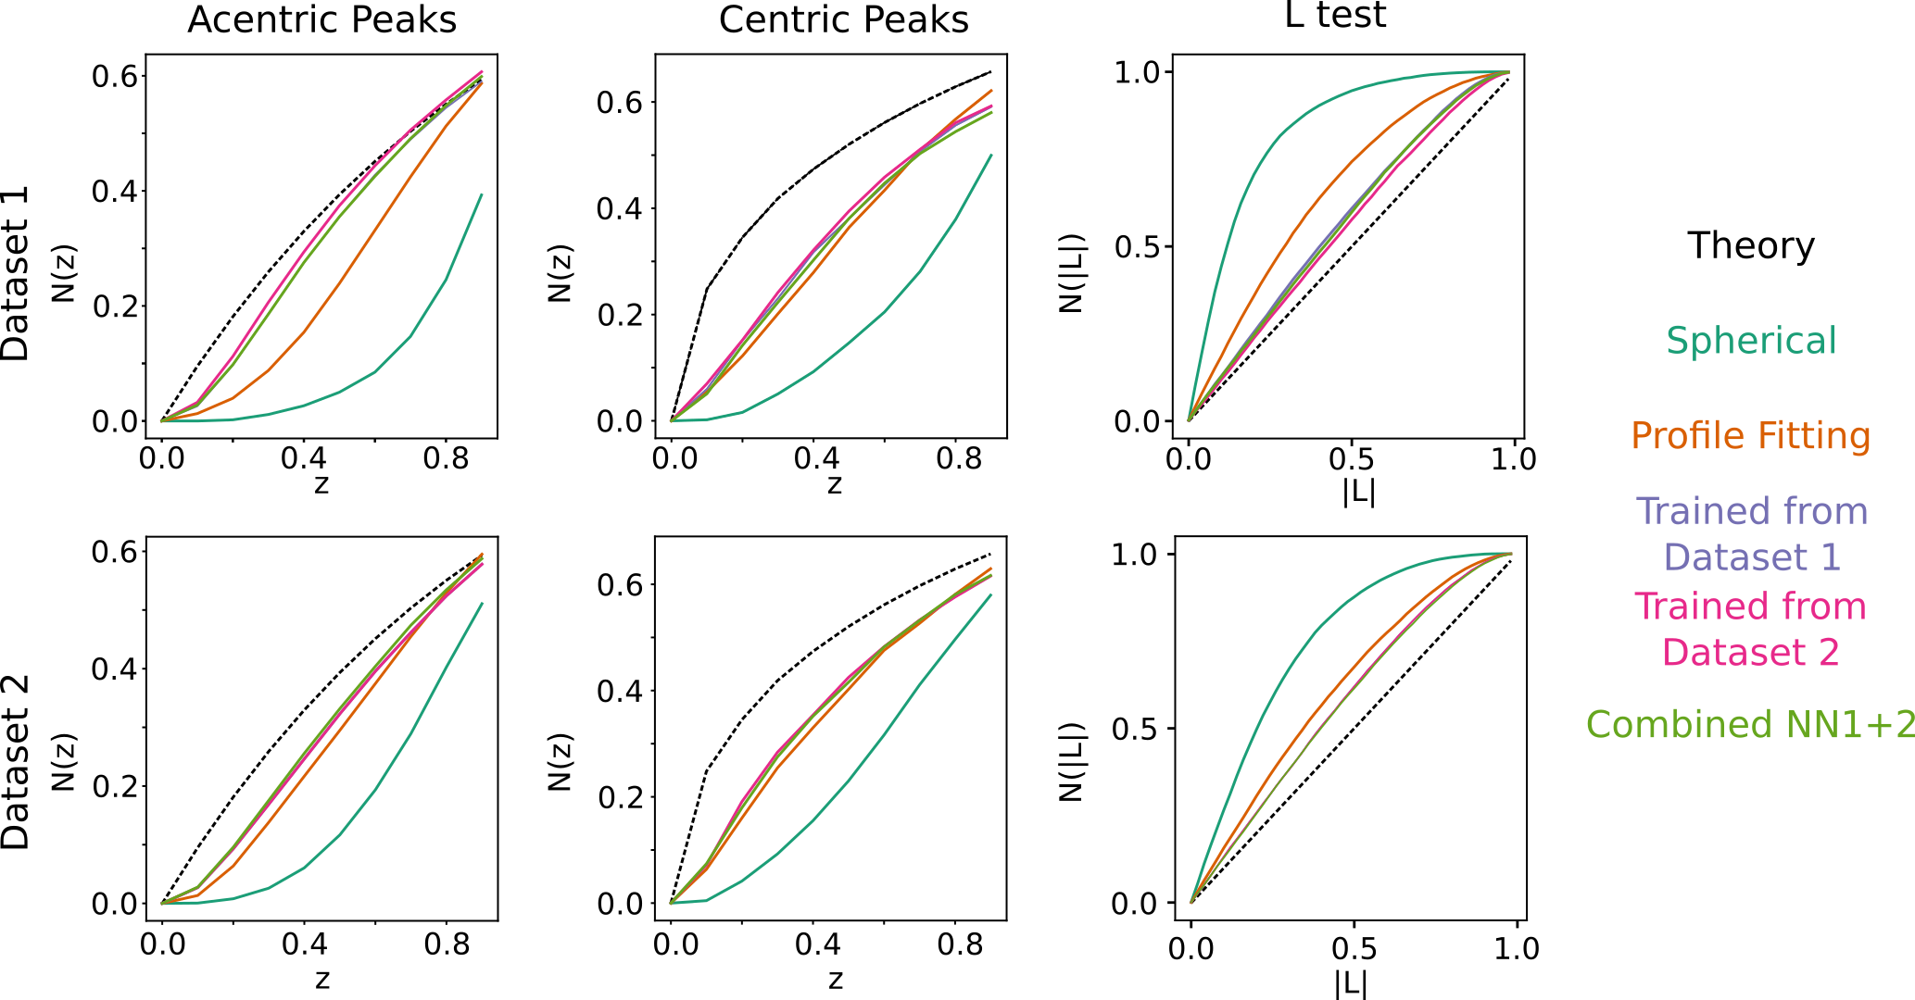
Intensity Distributions demonstrate that profile fitting integration is more accurate

Slide 18
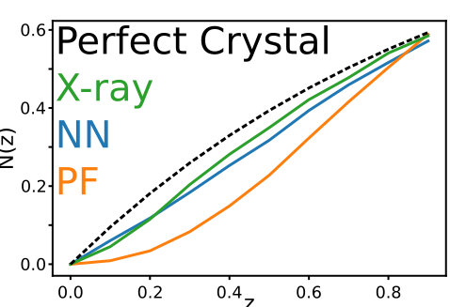
This work demonstrates transfer learning is possible for peak integration
No major differences between statistics or maps depending which set we train against
First step towards developing a universally applicable integration network
This is needed for new samples that users bring
More recent work shows extends beyond the similar crystals
Especially for more challenging samples

Slide 19
Integration using a neural network is ~100 x faster
Profile fitting takes several hours to integrate
Users need faster feedback to inform how they use beamtime
Using neural networks, we gain a factor of 100 increase in speed
Envision deploying for large scale autoreduction to give near real-time feedback
Integration Method | Time per Peak (ms)
Spherical | 5.04
PF | 780.03
ML | 8.11

Slide 20
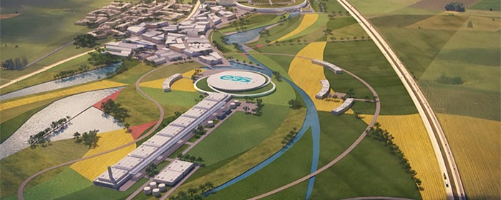
Future neutron and X-ray sources can benefit from deep learning-based data analysis
New XFELs will produce data at a rate of ~100 GB/s and require near real-time peak integration
Peaks not perfectly modeled yet, may need ML for accuracy and speed
Next generation of neutron sources will have much higher fluxes
Electron diffraction uses electrons instead of neutrons – remains difficult to model
European Spallation Source
(Under Construction)
Electron Diffraction
Pump-Probe Crystallography
at LCLS (from LCLS website)

Slide 21
Acknowledgements
ORNL: Rick Archibald, Vickie Lynch, Leighton Coates, Patricia S. Langan, Venu Vandavassi, Paul Langan
Samples used for testing grown at the Center for Structural and Molecular Biology, ORNL by Holger Dobbek and Martin Bommer (Humboldt-Universitat zu Berlin), Robert McFeeters (University of Alabama, Huntsville), Martin Egli and Joel Harp (Vanderbilt University)
Funding: NIH R01-GM071939

