Slide 1
An Evaluation Of Transfer Learning for Classifying Sales Engagement Emails at Large Scale
Yong Liu, Pavel Dmitriev, Yifei Huang, Andrew Brooks, Li Dong

Slide 2
Outline
Background
Sales Engagement Platform
Problem: Email Intent Classification @ SEP
High Performance Transfer Learning for Email Intent Classification
Definition of HPTL
Research Goal and Research Questions
Experiments and Datasets
Results and Summary
Limitation and Future Work

Slide 3
Background: Sales Engagement Platform

Slide 4
Sales Engagement: the book (March 2019)
Notes:
It’s also a website and a podcast.
Our founders, CEO, and sales leaders wrote it help define this growing market segment.

Slide 5
Sales Engagement Platform (SEP)
A new category of software
A single system of action (Email, phone call, meeting etc.)
Reps
Sales Engagement Platform (SEP)
(e.g., Outreach)
CRMs (e.g., Salesforce, Microsoft Dynamics, SAP)
Notes:
Email is the core channel for communicating with prospects—The most popular sales engagement platforms are built around email capabilities. And in today’s digital world, sales communications center around email, which is the most efficient and effective method for connecting to prospects at scale. For example, outbound touch patterns are typically created around email sends. Touch-pattern design starts when the emails are going to be sent (for example, on day 1, 3, 7, and 14). Everything else (phone, social, etc.) is set up to support the email campaign.

Slide 6
Over 3000 organizations use
Outreach product daily

Slide 7
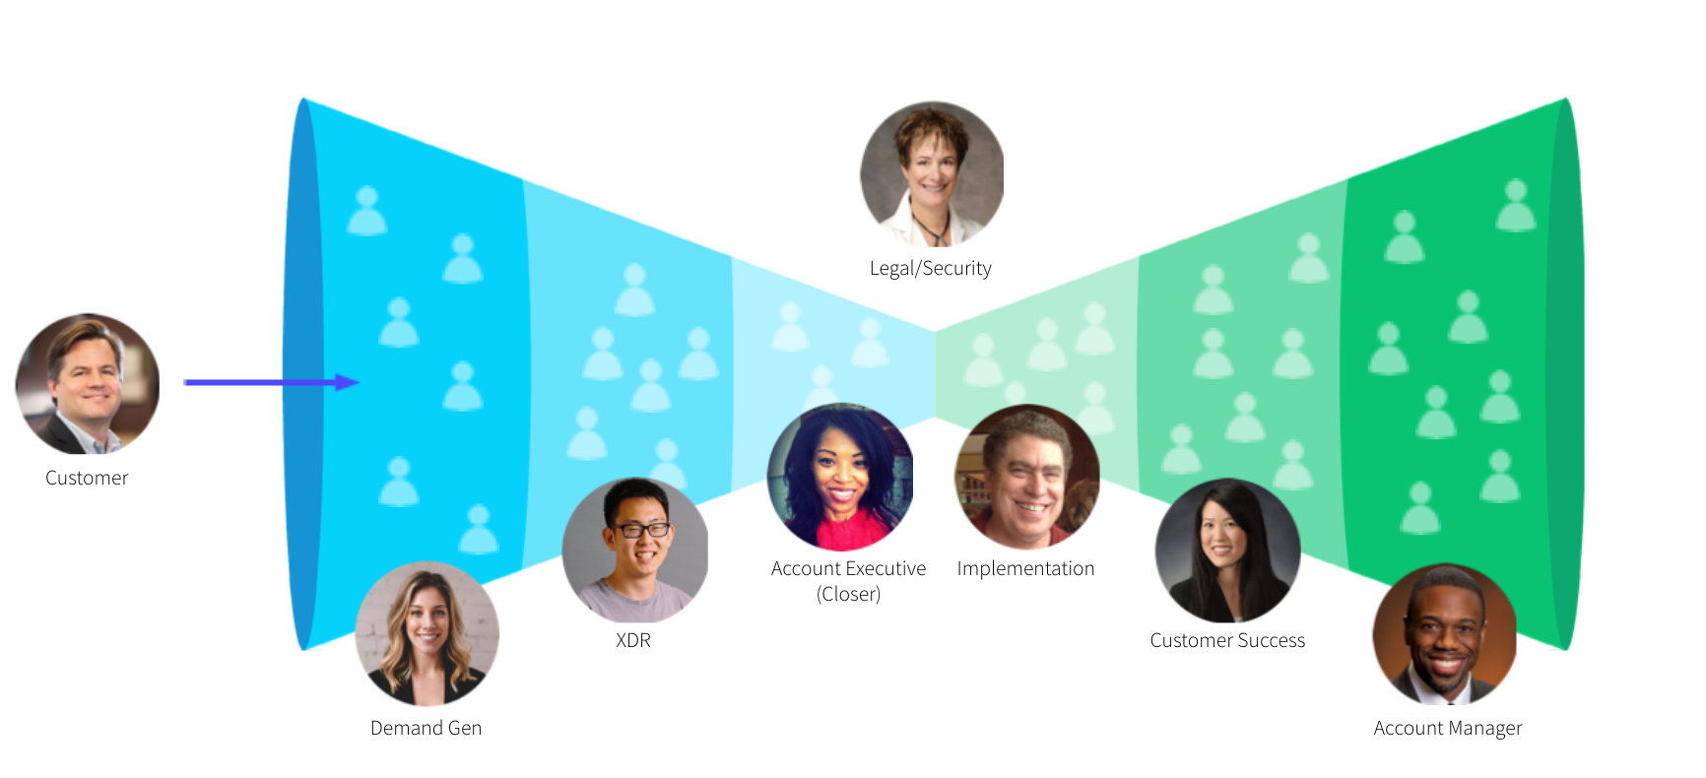
Delivering Value Across the Customer Life Cycle
(Hunter)

Slide 8
SEP Encodes and Automates Sales Activities into Workflows
Enables reps to perform one-on-one personalized outreach to up to 10x more prospects than before.
Day 5
Email
Day 5
Phone
Day 3
LinkedIn
Day 1
Email
Day 1
Phone Call
Automates execution and capture of activities (e.g., emails) and records in a CRM.
Schedules and reminds the rep when it is the right time to do the manual tasks (e.g. phone call, custom manual email)

Slide 9
Problem: Email Intent Classification @ SEP

Slide 10
Email Intent Classification @ SEP: What & Why?
Email is a core communication channel @ SEP
Email content is critical for driving results for prospecting and other stages of the sales process
Reply rate was the common metric for A/B testing different email content/templates
Problem: Not all replies are created equal
Going beyond reply rate: from counting to classification
Detect and classify the intent of the reply (e.g., positive, objection, unsubscription)
Measure the performance of email templates based on the reply intent
Use reply intent-based metrics (such as positive reply rate) for A/B testing

Slide 11
Email Intent Classification @ SEP: Why is it challenging?
Heterogenous context and different roles of players
Non-standard sales process progression
Different organizations with different specialized department and job roles
Limited Labeled sales engagement domain emails
No publicly available sales engagement domain email corpus
GDPR and privacy/compliance-constraints
Time-consuming and impossible to label many emails across many orgs

Slide 12
High Performance Transfer Learning for Email Intent Classification @ SEP: Research Goal and Research Questions Experiments & Dataset

Slide 13
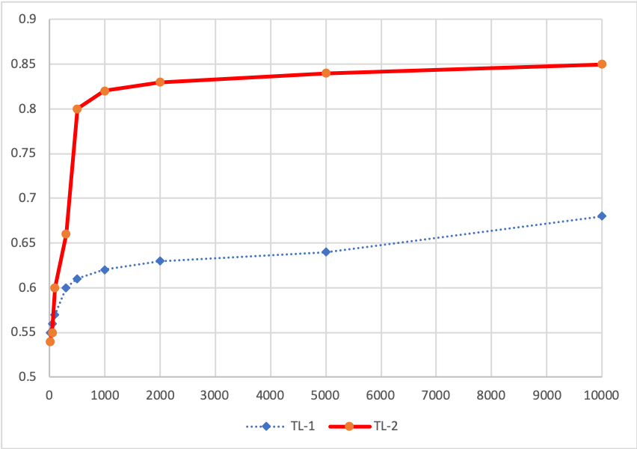
High Performance Transfer Learning
Natural Language Processing (NLP) task leaderboard success of transfer learning using pretrained language models such as BERT
High performance transfer learning (HPTL)
Fewer training examples
Better accuracy
Reasonable model training time
HPTL!
# of training examples
Notes:
First verbally mention what’s transfer learning

Slide 14
Research Goal and Questions
Goal: Establish an evaluation framework for HPTL to classify email intent @SEP
Three research questions
1) What kind of pretrained language models (LMs) and embeddings work best?
2) What kind of transfer learning implementation strategies work best (feature-based vs. fine-tuning based)?
3) How much labeled data is enough?

Slide 15
Pretrained LMs and Embeddings Used
GloVe
count-based context-free word embeddings released in 2014
ELMo
context-aware character-based embeddings that is based on a recurrent neural network (RNN) architecture released in 2018
Flair
contextual string embedding released in 2018
BERT
state-of-the-art transformer-based deep bidirectional language model released in late 2018 by Google

Slide 16
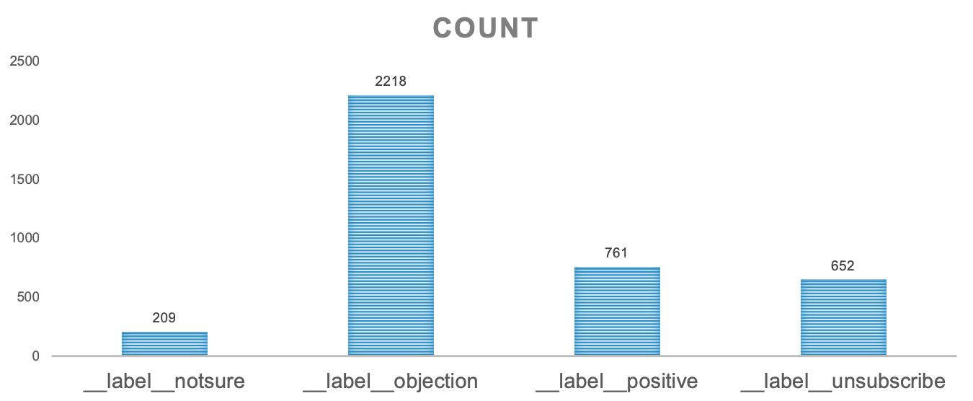
Experimental Email Dataset
In-house Outreach emails

Slide 17
Example Intents and Emails
Positive | Objection | Unsubscribe | Not-sure
"Actually, I'd be interested in talking Friday. Do you have some time around 10am?” | “Thanks for reaching out. This is not something I am interested in at this time.” | “Please remove me from your email list.” | “Mike, in regards to? John”

Slide 18
Two Sets of Experiment Runs
Exp 1: Compare Feature-based vs. Fine-tuning approaches using the full training examples
Using different pretrained LMs and embeddings for feature-based approach
Two different document representations were also compared
Implementation is based on the Flair framework
Using BERT for fine-tuning approach
Implementation is based on the official bert-tensorflow by Google
Exp 2: Compare scaling effect of different approaches using increasingly large training size
Training size: 50, 100, 200, 300, 500, 1000, 2000, 3000
The hold-out test dataset remains the same for all experiments
All experiments were run on an AWS (Amazon Web Service) cluster
p2.xlarge GPU cluster with 61 GB memory

Slide 19
Feature-based Approach
Advantages: faster training time without changing original pretrained model parameters
Disadvantages: task specific architecture; less accuracy
Pretrained LMs & Embeddings

Slide 20
Fine-tuning Approach
Advantages: few parameters need to be learned from scratch; higher accuracy
Disadvantages: moderate training time; needs to change pretrained model parameters
Label
Dropout + Log_Softmax
[pooled_output]
BERT

Slide 21
Results

Slide 22
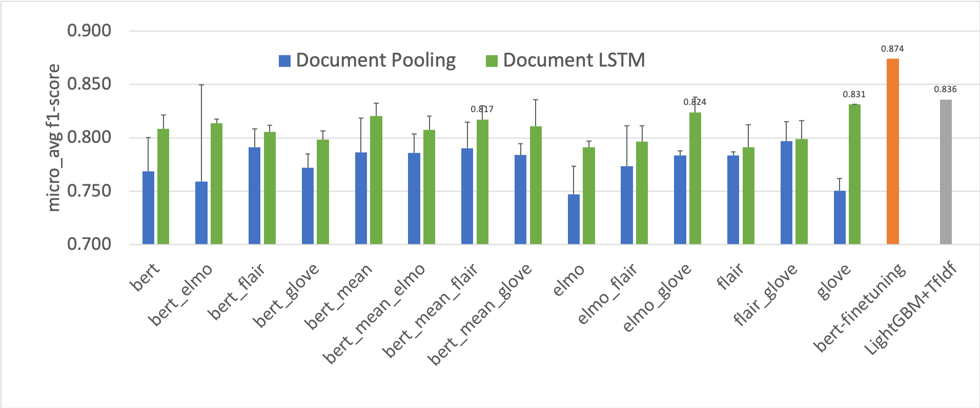
Result (1): Different Embeddings
BERT-finetuning has the best f1 score
When using Feature-based approach, GloVe performs slightly better
Traditional MLs such as LightGBM+TF-IDF underperform BERT-finetuning
Document LSTM consistently outperforms document pooling when using feature-based approach

Slide 23
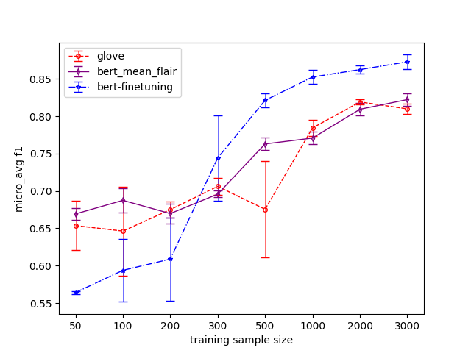
Result (2): Scaling Effect with Different Training Sizes
BERT-finetuning outperforms all other
Feature-based approaches when training
example size is greater than 300
When training size is small (< 100),
BERT+Flair performs better
To achieve an f1-score > 0.8,
BERT-finetuning needs at least 500 training
examples, while feature-based approach
needs at least 2000 training examples

Slide 24
Model Training Time

Slide 25
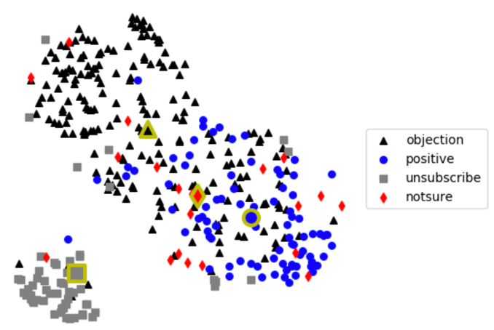
tSNE Visualization of Testing Dataset Prediction Results
GloVe
Prediction Results
BERT + Flair Prediction Results
BERT-finetuning Prediction Results

Slide 26
Summary
Transfer learning using fine-tuning BERT outperforms all feature-based approaches using different embeddings/pretrained LMs when training example size is greater than 300
Pretrained language models solve the cold start problem when there is very little training data
E.g., with as little as 50 labeled examples, the f1 score reaches 0.67 with BERT+Flair using the feature-based approach
However, to get to f1-score >0.8, it may still need one to two thousand examples for a feature-based approach or 500 examples for fine-tuning a pre-trained BERT language model.
BERT-finetuning is a HPTL method with a reasonable training time
The HPTL evaluation framework allows us to systematically evaluate different transfer learning methods

Slide 27
Limitation and Future Work

Slide 28
Limitation and Future Work
Current work only uses a single org’s email data at the prospecting stage
Extends HPTL to cross-org model development
Using one or multiple orgs’ emails to train and applying to many other orgs
Extends HPTL to cross entire sales process and different stages
Learning under different context while sales progresses

Slide 29
Thanks! Q & A

